Slide 1
Database Systems
Lecture 1
Introduction
Alina Arshad
alina.arshad@nu.edu.pk
Basement 2 Room#4

Slide 2
Tentative Mark Distribution and Grading Policy
Assignments: 10 %
Mid Exams: 30 %
Final: 50%
Presentations + Projects: 10%

Slide 3
Course Ethics
Projects/Assignments
Deadlines are always final
No credit for late submissions
Project Proposal Submission : 3rd Week
Project Presentation : Last week

Slide 4
Course Objective:
To Understand the basic concepts and the applications of database systems
To Master the basics of SQL and construct queries using SQL
To understand the relational database design principles
To become familiar with the basic issues of transaction processing and concurrency control
To become familiar with database storage structures and access techniques

Slide 5
Course Outcomes:
By the end of the course, the student will be able to
Describe a relational database and object-oriented database
Create, maintain and manipulate a relational database using SQL
Describe ER model and normalization for database design
Examine issues in data storage and query processing and can formulate appropriate solutions
Outline the role and issues in management of data such as efficiency, privacy, security, ethical responsibility, and strategic advantage

Slide 6
Data VS Information
Data
Information
Khi | Sales | Isb
10 | Lhr | 20
Marketing | 30 | Production
DEPT_No | DEPT_Name | DEPT_Location
10 | Sales | Khi
20 | Marketing | Lhr
30 | Production | Isl
Unsorted
Meaningless
Cannot use such type of data/info in any useful purpose.
Sorted
Meaningful & understandable
Can use this data/info for extracting useful information.

Slide 7
Introduction
Data: Known facts that can be recorded and have an implicit meaning.
Database: a highly organized, interrelated, and structured set of data.

Slide 8
General Idea:
Essential component of life: most of us encounter several activities every day that involve some interaction with a database.
Banking(money deposit and withdraw)
Hotel Reservation
Airline Reservation
Accessing online Library
Shopping (Daraz, AliExpress, Amazon etc.)
Car Booking (Careem, Uber etc.)

Slide 9
General Idea:
Traditional databases: Most of the information that is stored and accessed is either textual or numeric.
Non-traditional databases/Bigdata storage systems/ NOSQL systems: created to manage data for social media applications.
Facebook (Posts, images and video clips)
Twitter (Tweets, images and video clips)
Google
Amazon
Yahoo
A large amount of data now resides on the “cloud”. which means it is in huge data centers using thousands of machines.

Slide 10
Introduction
A database can be of any size and complexity.
An example of a large commercial database is Amazon.com. It contains:
Data for over 60 million active users, and millions of books, CDs, videos, DVDs, games, electronics, apparel, and other items.
The database occupies over 42 terabytes.

Slide 11
What Is Database?
A database is an organized collection of structured information, or data, typically stored electronically in a computer system.
OR
A database represents some aspect of the real world, sometimes called the miniworld or the universe of discourse (UoD).
Data within the most common types of databases in operation today is typically modeled in rows and columns in a series of tables to make processing and data querying efficient.
The data can then be easily accessed, managed, modified, updated, controlled, and organized. Most databases use structured query language (SQL) for writing and querying data.

Slide 12
Why Databases?
Businesses cannot run without knowing their data: customers, products, prices, employees, wages, etc.?
Properly maintained data is important in decision making and hence in the success of a business.
The amount of data utilized in a business can grow fast.
Examples:
Phone companies keep data on trillions of phone calls, adding 70,000 calls per second.
Google is estimated to perform 91 million searches per day across a data that is several terabytes in size.
How do these businesses maintain this data? and do searches on this data to find desired information?
Answer: By using Databases

Slide 13
Difference Between A Database And A Spreadsheet?
Spreadsheets were originally designed for one user, and their characteristics reflect that. They’re great for a single user or small number of users who don’t need to do a lot of incredibly complicated data manipulation.
Databases, on the other hand, are designed to hold much larger collections of organized information—massive amounts, sometimes. Databases allow multiple users at the same time to quickly and securely access and query the data using highly complex logic and language.

Slide 14
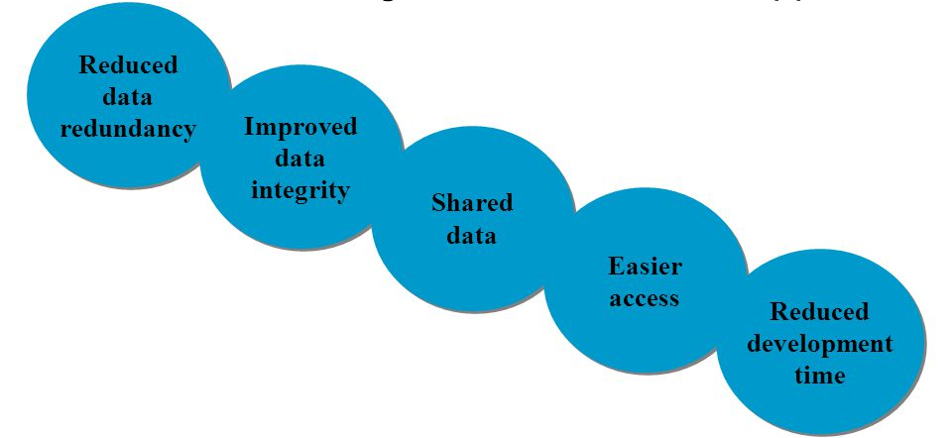
Characteristics of DB Approach

Slide 15
Properties of Database
A database has the following implicit properties:
A database represents some aspect of the real world, sometimes called the mini world or the universe of discourse (UoD). Changes to the mini world are reflected in the database.
A database is a logically coherent collection of data with some inherent meaning. A random assortment of data cannot correctly be referred to as a database.
A database is designed, built, and populated with data for a specific purpose.
It has an intended group of users and some preconceived applications in which these users are interested.

Slide 16
What Is DBMS?
A database typically requires a comprehensive database software program known as a database management system (DBMS). A DBMS serves as an interface between the database and its end users or programs, allowing users to retrieve, update, and manage how the information is organized and optimized.
Some examples of popular database software or DBMSs include MySQL, Microsoft Access, Microsoft SQL Server, FileMaker Pro, Oracle Database, and dBASE.
Notes:
DBMS (Database Management System): Think of a DBMS as a software tool that acts as a bridge between the data stored in a database and the people or programs that need to use it

Slide 17
Types of DBMS
Relational(SQL databases)
Data Model is based on tables
Non-Relational(NoSQL databases)
Data Model is based on XML,JSON or Plain Text i.e. no tabular form of database.
Network
Data Model based on graph with nodes as records and relationship between records as edges.
Hierarchical
Data Model based on tree data structure
Object Oriented
Data Model based on Object Oriented paradigm
Distributed
Composed of several independent DBMS running at the nodes of a Communication Network.
Notes:
Distributed dataset such as google search engine

Slide 18
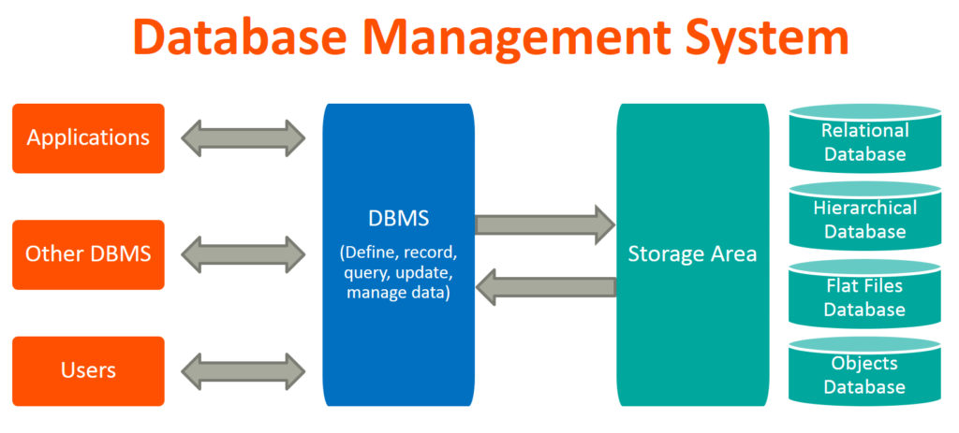

Slide 19
Any question????

